Slide 1
Expanding an Enterprise
Using Foursquare and Folium to Map Potential Business Locations

Slide 2
The Scenario
A fictional company (the Company) provides services leveraging geolocation data to address the needs of organizations.
An IT managed service provider, specializing in serving small to medium size business (the Client) is looking to expand operations by establishing a satellite office, and has approached the Company to provide recommendations for locations.
The Client shared several requirements proposed locations including but not limited to:
Over 20 miles from current location, but not more than 45 miles of current location (located in Rockland County, NY 41.1489 N, 73.9830 W).
Mix of small to medium size businesses as well as highway, secondary, and tertiary routes and mass transit options within 5-mile radius.
Minimize commuter chokepoints like bridges, tunnels, tolls, etc between current location and new location.
Off-street parking / lot.

Slide 3
Data Assumptions
Drawing on sociological research the Company notes that located within or by affluent communities provide several advantages.
Affluence operationalized by measuring per-capita income based on municipality.
Affluence can be operationalized by measuring per-capita income.
Per-capita income can be geographically clustered.

Slide 4

Data Acquisition
Drawing on sociological research the Company notes that located within or by affluent communities provide several advantages.
Affluence operationalized by measuring per-capita income based on municipality.
Affluence can be operationalized by measuring per-capita income.
The 100 communities with the highest per capita incomes were found and scraped from web.
Communities arranged according to ZCAT (Zip Code Tabulation Area – produced by the US Census Bureau).
Data was cross referenced with ZIP codes (Zone Improvement Plan Code – produced by the US Postal Service)

Slide 5
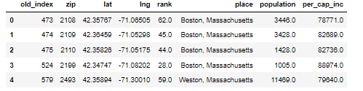
Data Cleaning
Dataframes containing ZCATs cross referenced with Zipcodes
Dataframe with information about the following created:
Name of town (place)
Per Capita Income
Rank (in terms of per-capita income)
Population
Zip Code
ZCATs
Latitude
Longitude

Slide 6
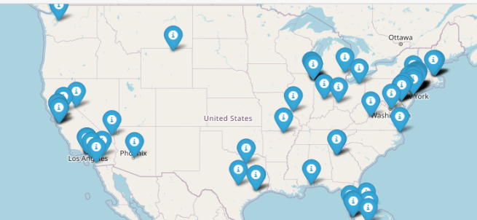
Methods
100 communities plotted

Slide 7
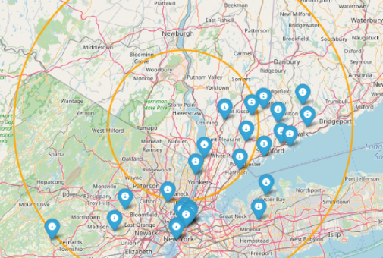
Methods 1
First requirement: Distance from existing office must be between 25 and 45 miles

Slide 8
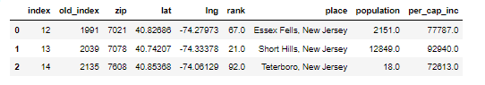
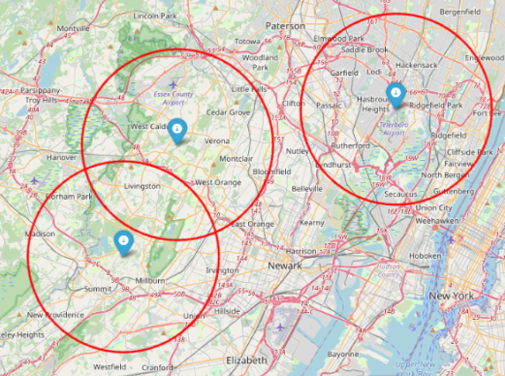
Methods 2
Next set of requirements addressed:
Access to highway and mass transit within five miles of city center
Alternative access on secondary roads that avoid chokepoints
Three localities fit this description
Essex Feels, NJ
Short Hills, NJ
Teterboro, NJ

Slide 9
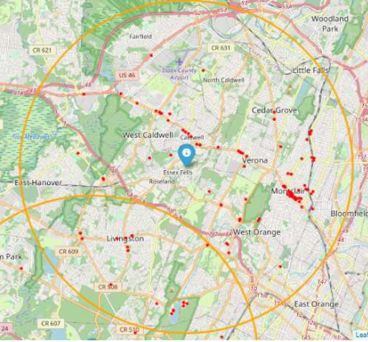
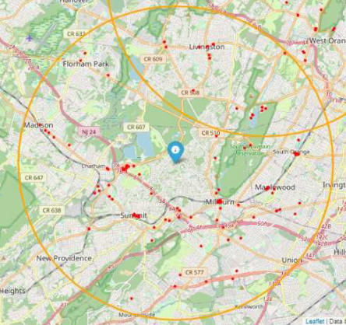
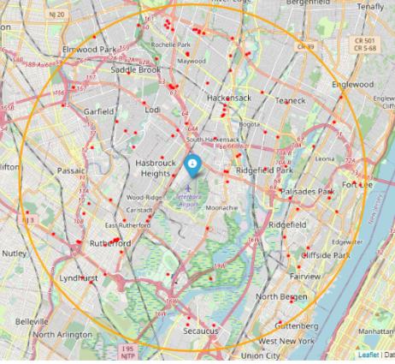
Methods 3
A Foursquare API call to provide the Client with a pool of possible clients in each location.
Essex Fells Potential Clients
Short Hills Potential Clients
Teterboro Potential Clients

Slide 10
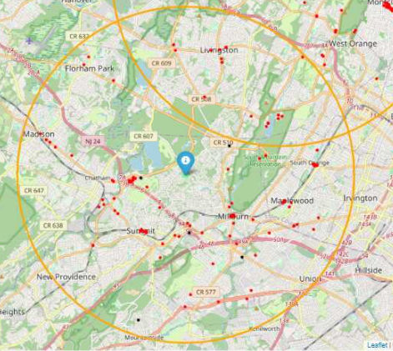
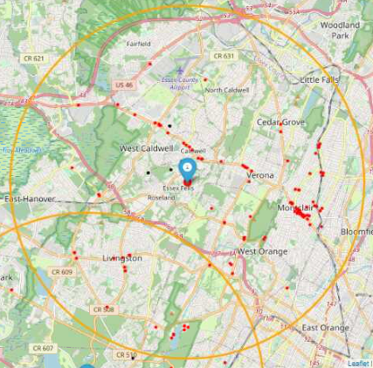
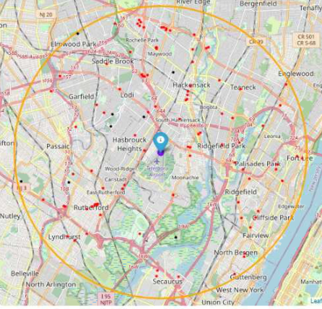
Bonus Mapping
As a bonus – potential competitors were scouted and mapped
Labeled with black markers they were overlayed onto the map with potential clients (in red)
Short Hills: Potential Competitors & Potential Clients
Essex Fells – Potential Competitors & Potential Clients
Teterboro: Potential Competitors & Potential Clients

Slide 11

Discussion & recommendations
After reviewing the visual data, the Company recommends to the Client to consider not an area, but rather a corridor that exists between Essex Fells and Short Hills.

Slide 12
Conclusion

